Slide 1

Diplomatura en Ciencias de Datos
Trabajo Práctico Final
Módulo 1
Integrantes: Gamboa Juliana, Mancini Andrés, Pavelek Israel

Slide 2
Objective
Objective
To extract valuable information about events, shoppers, products and brands from an ecommerce dataset.
To define Retargeting and Remarketing actions based on data collected from ecommerce purchases, views and carts.

Slide 3
Dataset
Methods
Original dataset : 6084217 entries and 9 columns
event_time: event time (UTC)
event_type: View, Chart, Puchase
produc_id: product identifier
category_id: category identifier
category_code: product category (levels tree)
brand: product brand
price: product price (U$$)
user_id: user identifier
user_session: user session

Slide 4
Dataset cleaning
Methods
‘Event_time‘ column is converted to date format and new columns are created referring to temporary events:
Month
Day
Hour
Then, ‘Event_time’ column is removed

Slide 5
Category_code split
Methods
“Category code” column is a category tree that is separated into different columns for further processing
category_code
L0
L1
L2
L3
Format: L0.L1.L2.L3
electronics.audio.headphone
electronics
audio
headphone
None
+4 New columns

Slide 6
Duplicates cleaning
Methods
Rows with coincident data are removed
Dataset´s rows
Complete dataset
Clean Dataset
6084217
4631588

Slide 7
October results
General exploratory analysis
Smartphone | 72.0%
Audio | 9.9%
Clocks | 8.0%
Video | 6.4%
Tablet | 1.9%
Main categories
4631588
Electronics | 57.0%
Appliances | 16.6%
Computers | 7.6%
Apparel | 5.5%
Furniture | 4.1%
Filter
Filter
1286822
General event type distribution
1788400
Purchase | 4.9%
Cart | 3.7%
View | 91.4%
Total users
Purchase shoppers
1028553
124354
12.09%

Slide 8
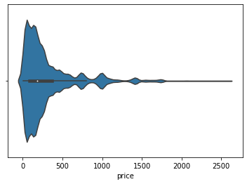
October results
Purchase
227157
Brand distribution
Samsung | 25.0%
Apple | 20.5%
Xiaomi | 8.2%
Huawei | 3.5%
Lucente | 1.7%
TOP 5
SAMSUNG
Price
(mean ± SD)
92.8% → Electronics
82.6% → Category_id: 2053013555631882655
83.1% → Smartphones
U$$ 306.17 ± 347.34

Slide 9
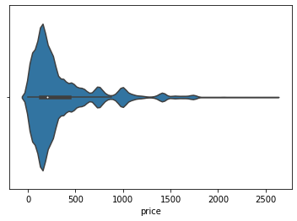
October results
Cart
170156
Brand distribution
Samsung | 33.8%
Apple | 24.0%
Xiaomi | 10.6%
Huawei | 4.7%
Oppo | 2.3%
TOP 5
SAMSUNG
Price
(mean ± SD)
93.5% → Electronics
82.6% → Category_id: 2053013555631882655
83.0% → Smartphones
U$$ 341.58 ± 357.24

Slide 10
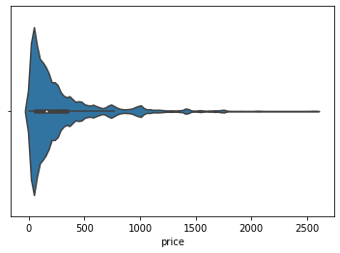
October results
Views
4234275
Brand distribution
Samsung | 13.6%
Apple | 11.2%
Xiaomi | 7.9%
Huawei | 2.9%
Lucente | 2.0%
TOP 5
SAMSUNG
Price
(mean ± SD)
87.5% → Electronics
71.6% → Category_id: 2053013555631882655
73.4% → Smartphones
U$$ 281.95 ± 355.81

Slide 11
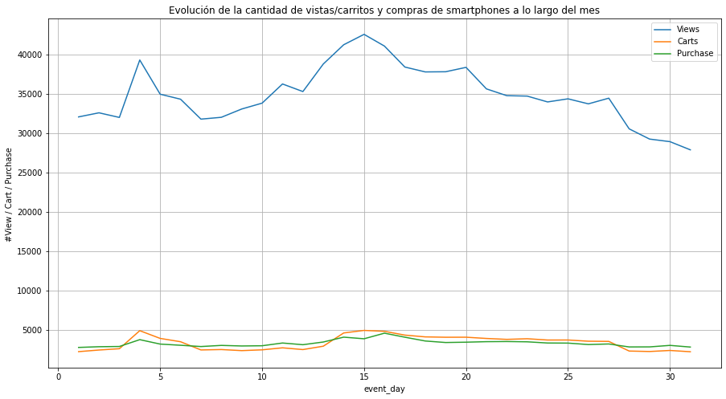
October results
Event type distribution
1286822
TOP 1
SMARTPHONE
Category
#View: 1081711 (84.1%)
#Cart: 103262 (8.0%)
#Purchase: 101849 (7.9%)

Slide 12
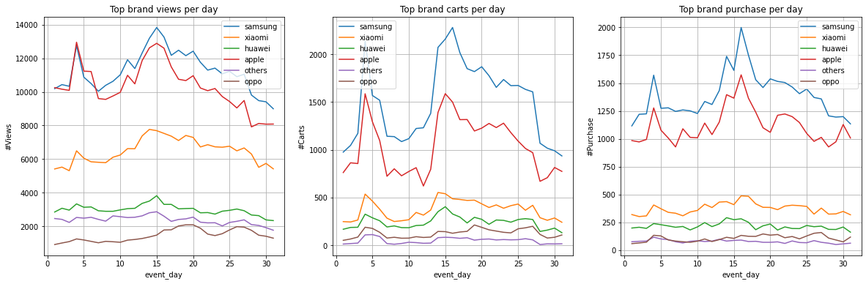
October results
Brand distribution
Samsung | 34.1%
Apple | 30.2%
Xiaomi | 17.5%
Huawei | 8.3%
Oppo | 4.1%
SMARTPHONE
TOP brands:
Peaks around 5th and 15th days.
TOP 5
40
Different
BRANDS

Slide 13
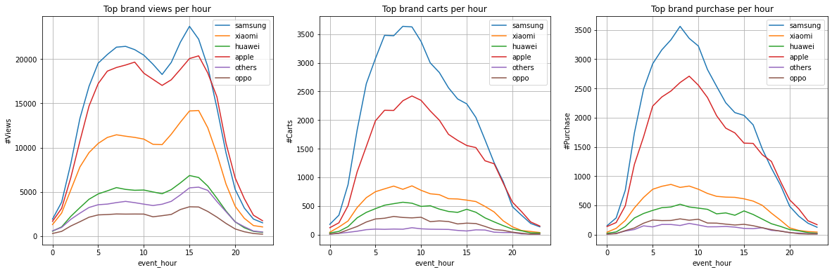
October results
Brand distribution
SMARTPHONE
Remarketing actions
Retargeting actions
Top purchases hour range: 5-11 AM.
Views>>Purchases
“We miss you!”
Cart left: request to finish the purchase.

Slide 14
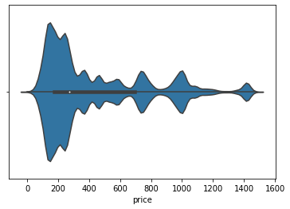
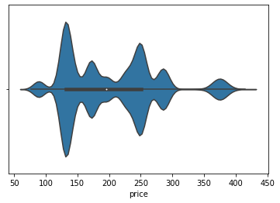
October results
Price distribution
SMARTPHONES
SAMSUNG SMARTPHONES
All events
& brands.
Purchase
& Samsung.
*Outliers were removed (<IQR*1.5)
*Outliers were removed (<IQR*1.5)
Price
(mean ± SD)
Price
(mean ± SD)
U$$ 436.44 ± 346.78
U$$ 202.70 ± 72.52

Slide 15
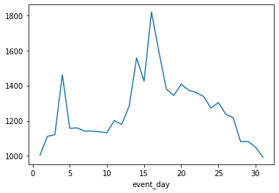
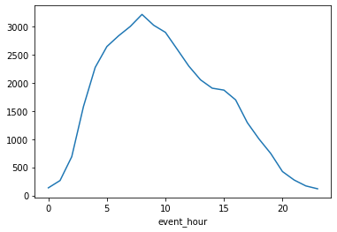
October results
Purchase & Event day & Event hour
Price
(mean ± SD)
SAMSUNG SMARTPHONES
U$$ 202.70 ± 72.52
1st weekend
Mother´s day
Top purchase hour range: 5-11 AM

Slide 16
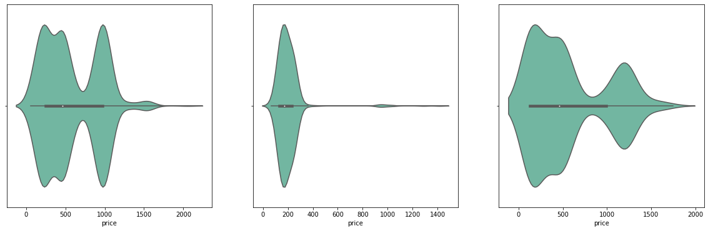
October results
General shopper analysis
Users == Purchase
Top users == purchase
12.1% of total users
124354
User_id | Counts | U$$
512386086 | 301 | 171 K
543312954 | 177 | 33 K
549109608 | 154 | 78 K
227157
PURCHASES
TOP 3
CUSTOMER PROFILE
User_id: 512386086
User_id: 543312954
User_id: 549109608
U$$ 566.81
± 346.18
U$$ 187.25
± 48.37
U$$ 504.56
± 401.28

Slide 17
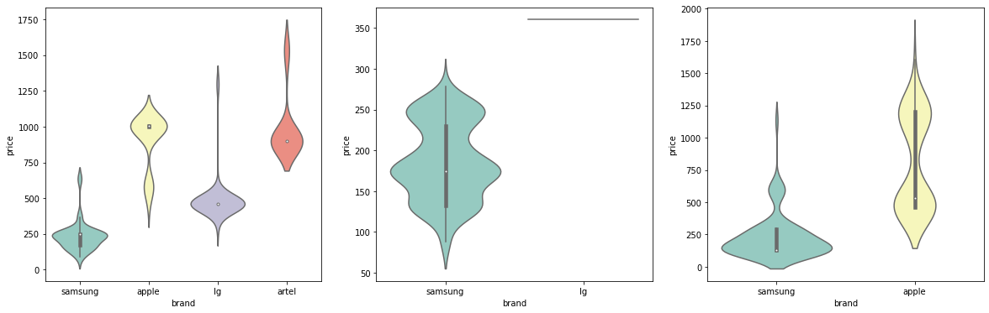
October results
Shopper purchase analysis: Top brands.
User_id: 512386086
User_id: 543312954
User_id: 549109608

Slide 18
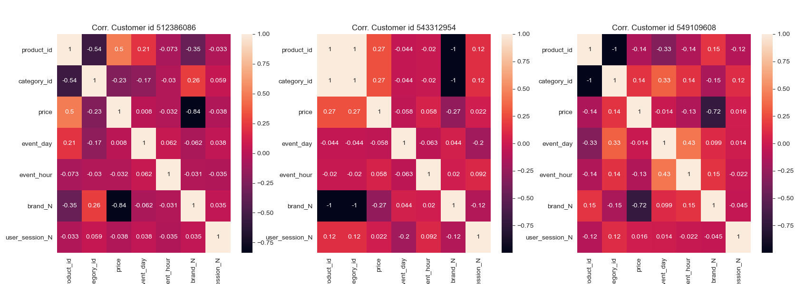
October results
General shopper analysis
Shopper 1
Shopper 2
Shopper 3
>>>corr: price & brand
>>corr: product_id & category_id price & product_id
>>>corr: product_id/category_id & brand
>>>corr: product_id & category_id
price & brand
>>corr: event_hour & event_day event_day & category_id/product_id

Slide 19
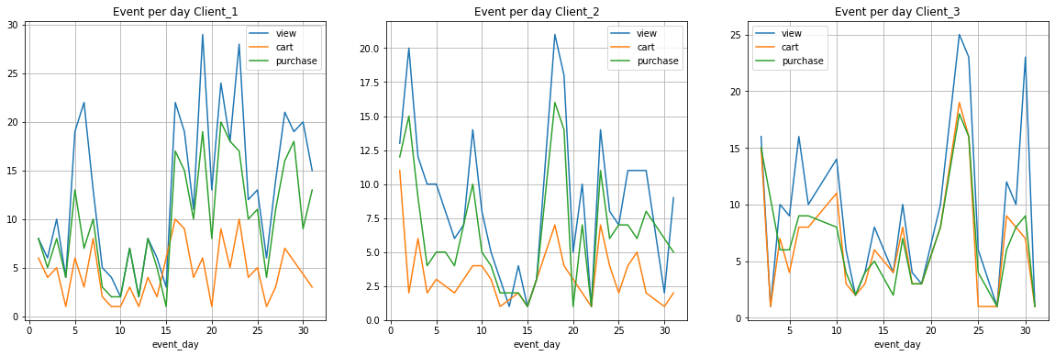
October results
Shopper analysis: Event type per day.
User_id: 512386086
User_id: 543312954
User_id: 549109608

Slide 20
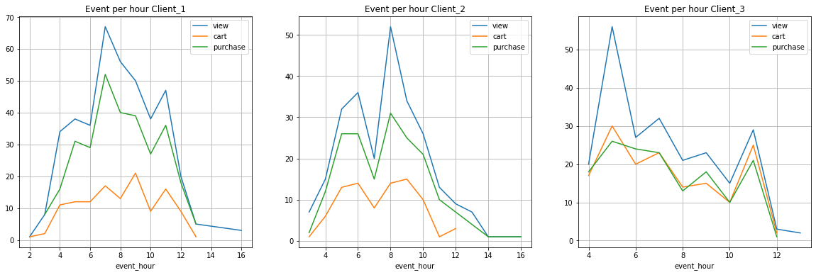
October results
Shopper analysis: Event type per hour.
Retargeting actions
Remarketing actions
Cart left: request to finish the purchase.
View>>Purchase
“We miss you!”
User_id: 512386086
User_id: 543312954
User_id: 549109608

Slide 21
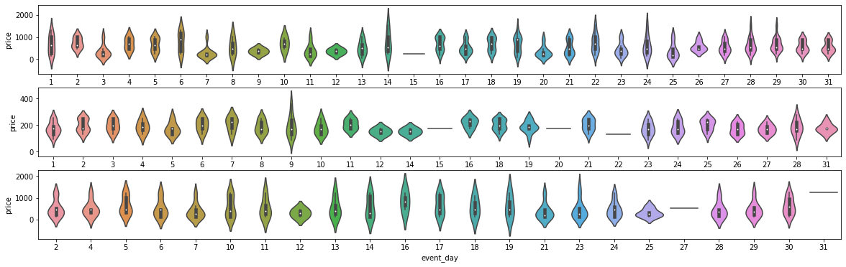
October
October results
Shopper profile analysis: purchase per day.
User_id: 512386086
User_id: 543312954
User_id: 549109608

Slide 22
Conclusions
Conclusion
It was identified that 12% of shoppers finished the purchase.
The shopper concentrated the purchases among 5 brands (59%).
Samsung was the most preferred brand, independently of the event type.
Electronics and Smartphones were the most preferred categories.
From event day distribution it was observed that purchases presented peaks in the first weekend and around the Mother´s day weekend.
Shoppers focused on recognized brands (such as Samsung) with prices (U$$ 202 ± 72) below the general average (U$$ 436.44 ± 346.78).
Since it was observed that 91.4% of entries were “views”, retargeting and remarketing actions were suggested. In this sense, it was identified the best hour-ranges as follows:
5-10 AM: retargeting
5-10 AM and 3PM: remarketing

